Slide 1
Optimization and Quantification of Error in image Classification Pipelines for noisy scientific image datasets

Slide 2
Outline
Problem definition and motivation
Our contributions
Minimization of classification error in image classification pipelines
Minimization of classification error in blood vessel morphology characterization using artificial parametric 3D models
Minimization of classification error in microstructure characterization using exhaustive grid search
Quantification of classification error in image classification pipelines
Machine learning based approach to quantify noise in medical images
Quantification of error contribution from image classification pipelines using methods for algorithm selection and hyper-parameter optimization
Conclusion

Slide 3
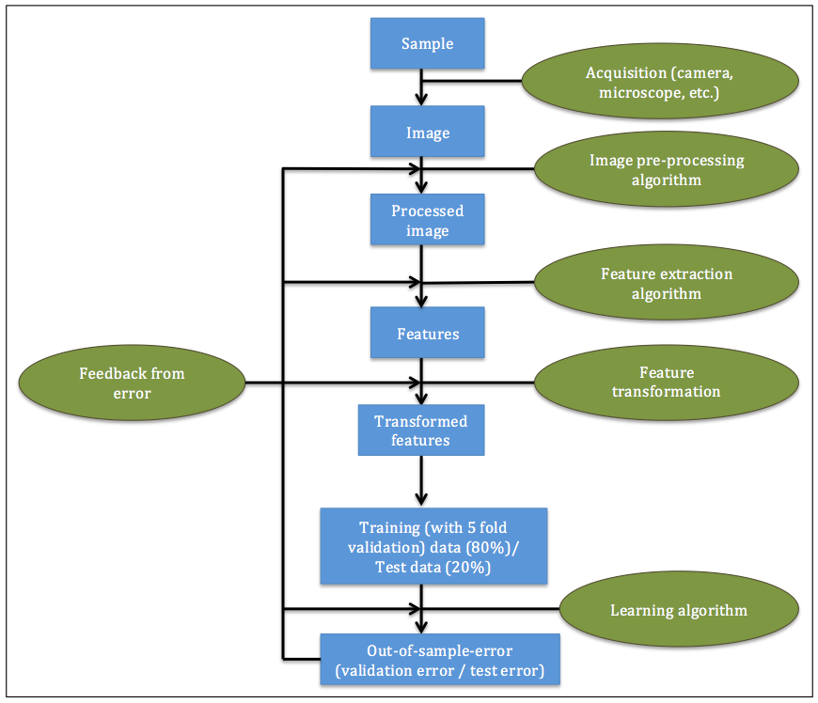
Image classification pipeline

Slide 4
Problem definition and motivation
Motivation: Classification error does not occur only due to the learning algorithm. It is caused by all the components of an image classification pipeline.
Problem: Minimize and quantify the classification error from different components of an image classification pipeline

Slide 5
Our contributions

Slide 6
Our contributions
Minimization of image classification error from different components
Minimization of error by modification of a particular component of the pipeline (Blood vessel morphology characterization using artificial parametric 3D models)
Minimization of error by optimizing the pipeline as a whole (Microstructure characterization using exhaustive grid search)
Quantification of error from different components
Quantification the quality of the data (A machine learning based approach to quantifying noise in medical images)
Quantification of error contributions from computational steps, algorithms and hyper-parameters in the pipeline

Slide 7
Minimization of error in image classification pipelines

Slide 8
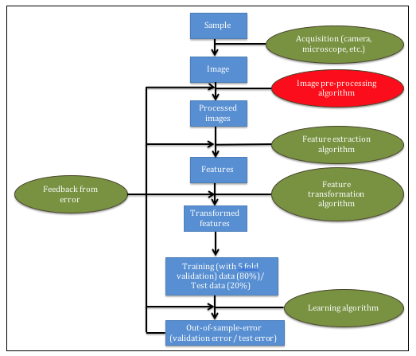
Blood vessel morphology characterization using artificial parametric 3D models [1]
Chowdhury, Aritra, et al. "Blood vessel characterization using virtual 3D models and convolutional neural networks in fluorescence microscopy." Biomedical Imaging (ISBI 2017), 2017 IEEE 14th International Symposium on. IEEE, 2017.

Slide 9
Introduction
Problem: Minimize classification error of blood vessel characterization by performing data augmentation using artificial parametric 3D models of vasculature.
Two classification tasks: Single blood vessels (RoundLumen) vs Double blood vessels (Twins), vessels with lumen (RoundLumen+) vs vessels without lumen (RoundLumen-)

Slide 10
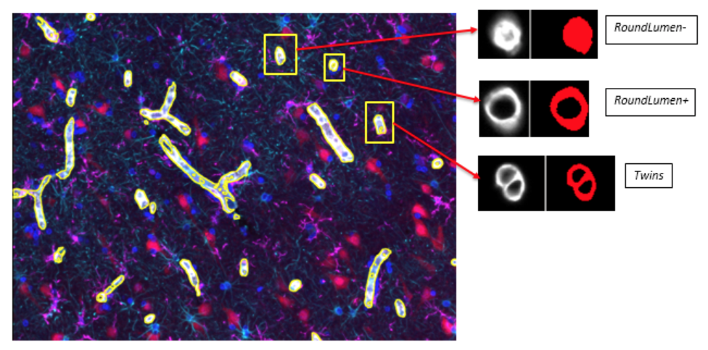
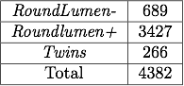
Data

Slide 11
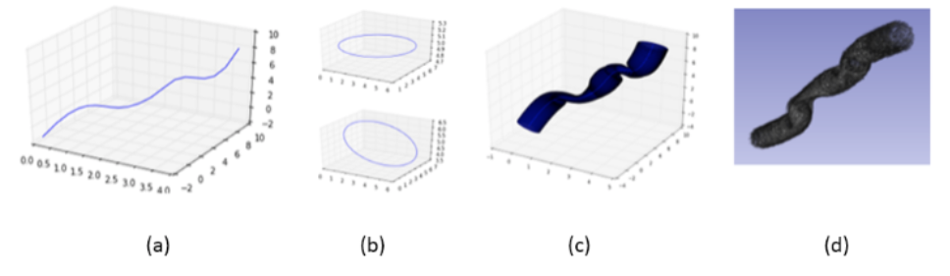
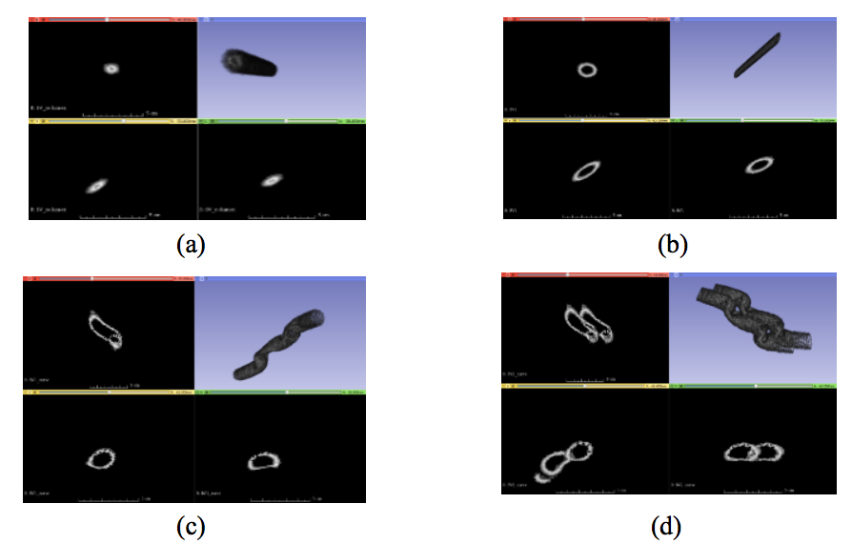
Artificial 3D model of vasculature

Slide 12
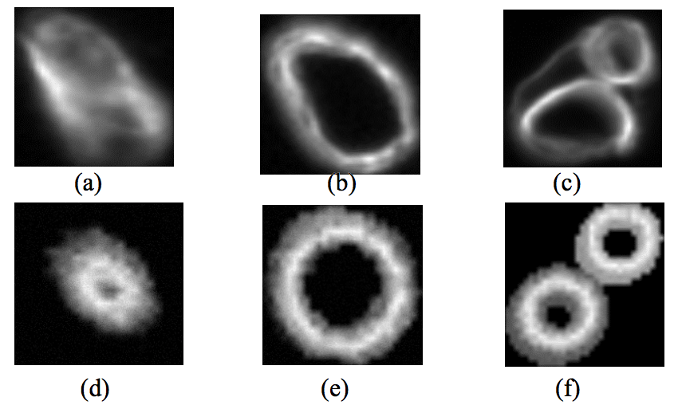
Natural and artificial data

Slide 13
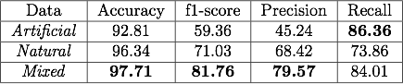
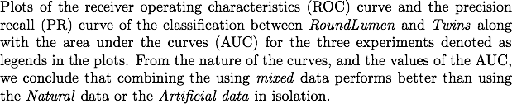
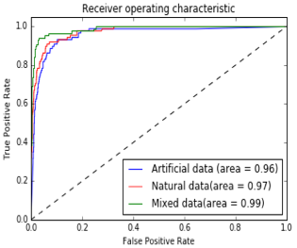
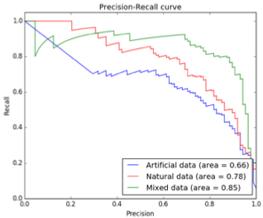
Results of task 1(RoundLumen vs Twins)

Slide 14
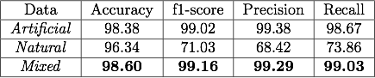
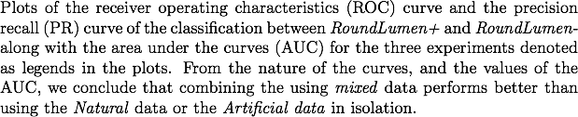
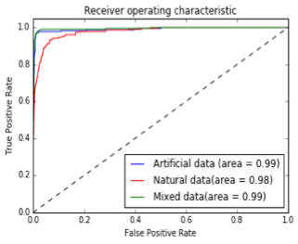
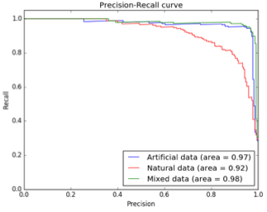
Results of task 2 (RoundLumen- vs RoundLumen+)

Slide 15
Discussion
Pre-trained convolutional neural networks maybe used to characterize blood vessel morphologies
Mixture of natural and artificial data increases the classification accuracy of blood vessel characterization.
Data augmentation using artificial parametric 3D models maybe used to reduce the error of classification.

Slide 16
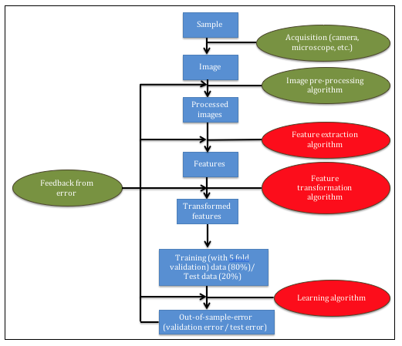
Microstructure characterization using exhaustive grid search [2]
Chowdhury, Aritra, et al. "Image driven machine learning methods for microstructure recognition." Computational Materials Science 123 (2016): 176-187.

Slide 17
Introduction
Problem: Find the best configuration of algorithms to characterize microstructures.
Two classification tasks: dendrites vs non-dendrites, longitudinal dendrites vs transverse dendrites.
Minimization of error in image classification pipeline as a whole by performing exhaustive grid search over the pipeline.

Slide 18
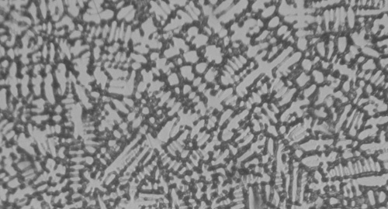
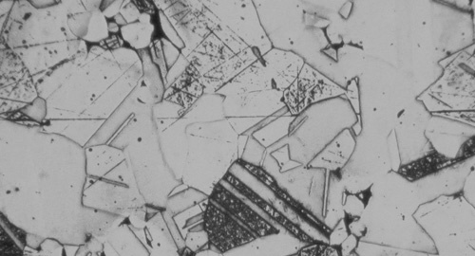
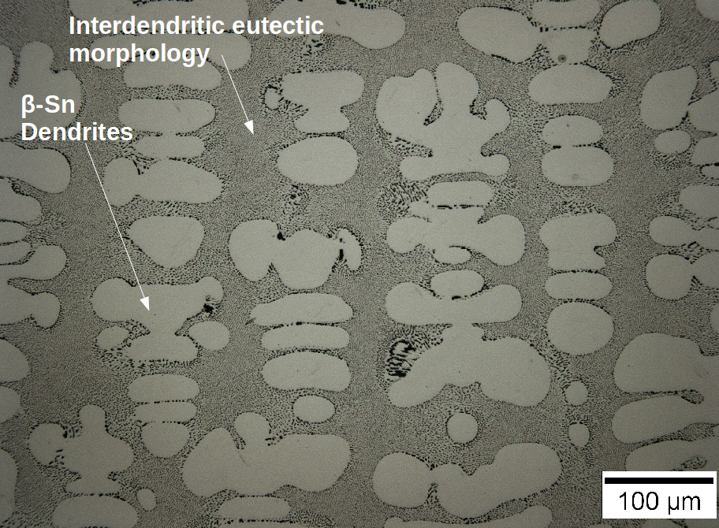
Classification tasks
Dendrite
Non-dendrite
Task 1
Longitudinal dendrite
Transverse dendrite
Task 2

Slide 19
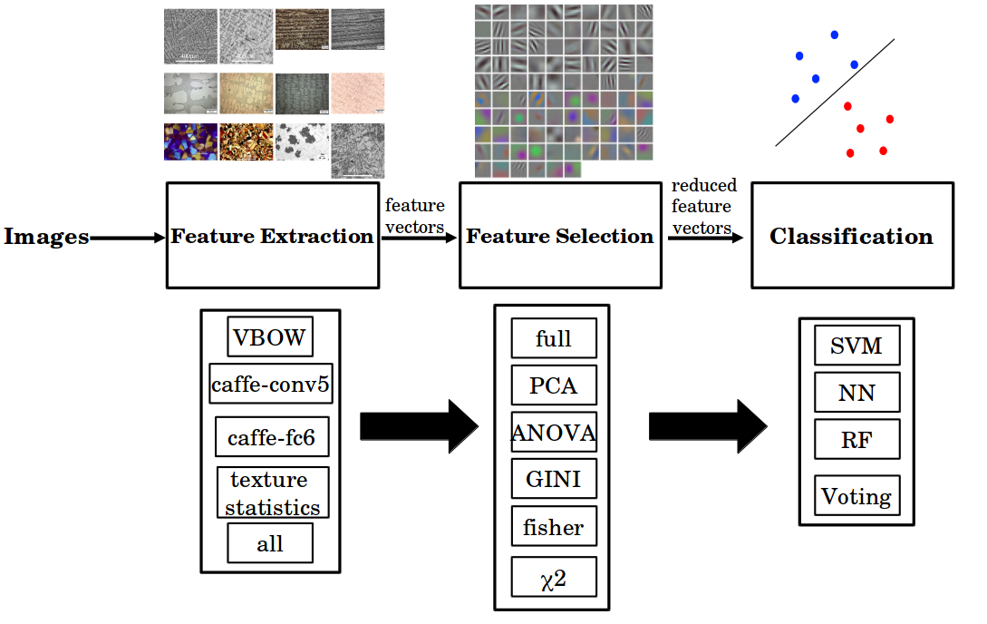
Image classification pipeline

Slide 20
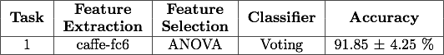
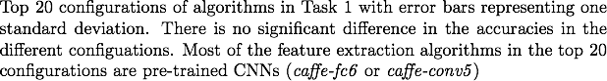
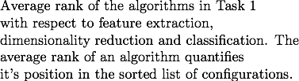
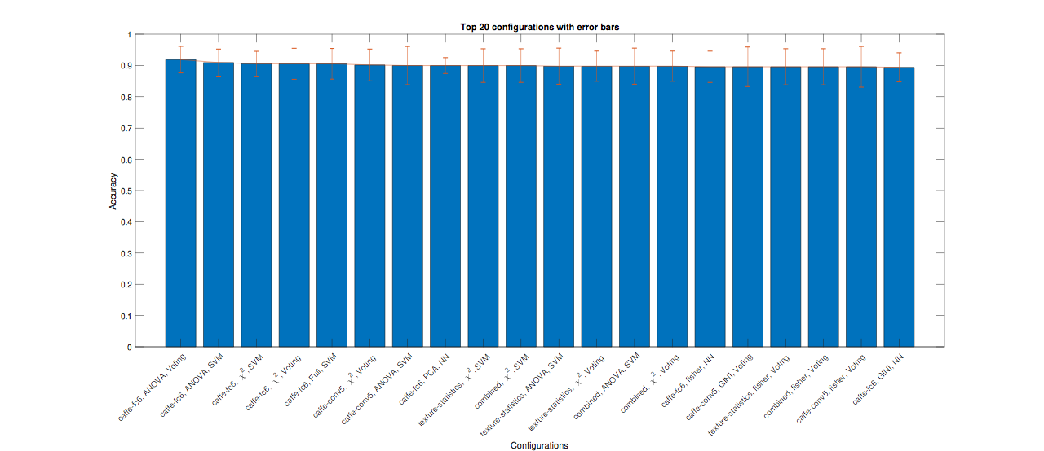
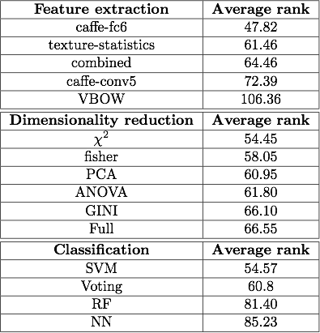
Results of Task 1 (dendrites vs non-dendrites)

Slide 21
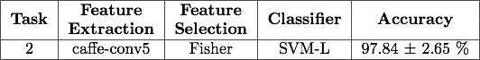
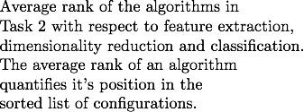
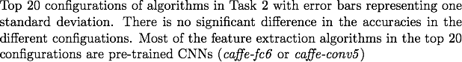
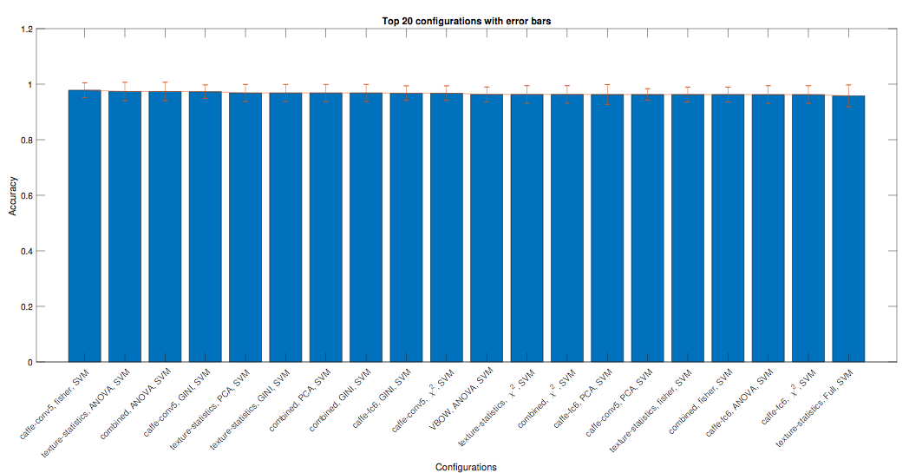
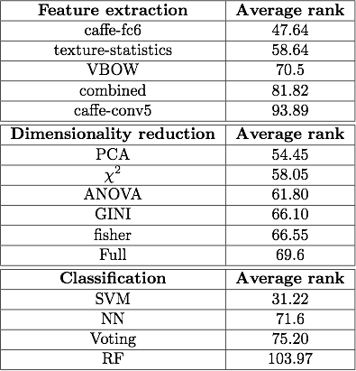
Results of Task 2

Slide 22
Discussion
The best configuration maybe found by minimizing the image classification pipeline as a whole using exhaustive grid search over algorithms and hyper-parameters.
Pre-trained neural networks (caffe-fc6) and SVM with a linear kernel maybe used to characterize and distinguish microstructural features.
Grid search and combined algorithm selection and hyperparamater optimization based methods can be used to minimize classification error in image classification tasks in material science and other domains.

Slide 23
Quantification of error in image classification pipelines

Slide 24
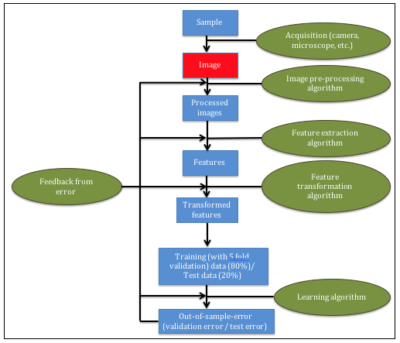
A machine learning based approach to quantify noise in medical images [3]
Chowdhury, Aritra, et al. "A machine learning approach to quantifying noise in medical images." Medical Imaging 2016: Digital Pathology. Vol. 9791. International Society for Optics and Photonics, 2016.

Slide 25
Introduction
Quality of Image (QoI) score that quantifies the amount of noise in an image.
The score may also be used to quantify the quality of a protein marker.
Haralick texture features, SMOTE, PCA and logistic regression is used to formulate the QoI.

Slide 26
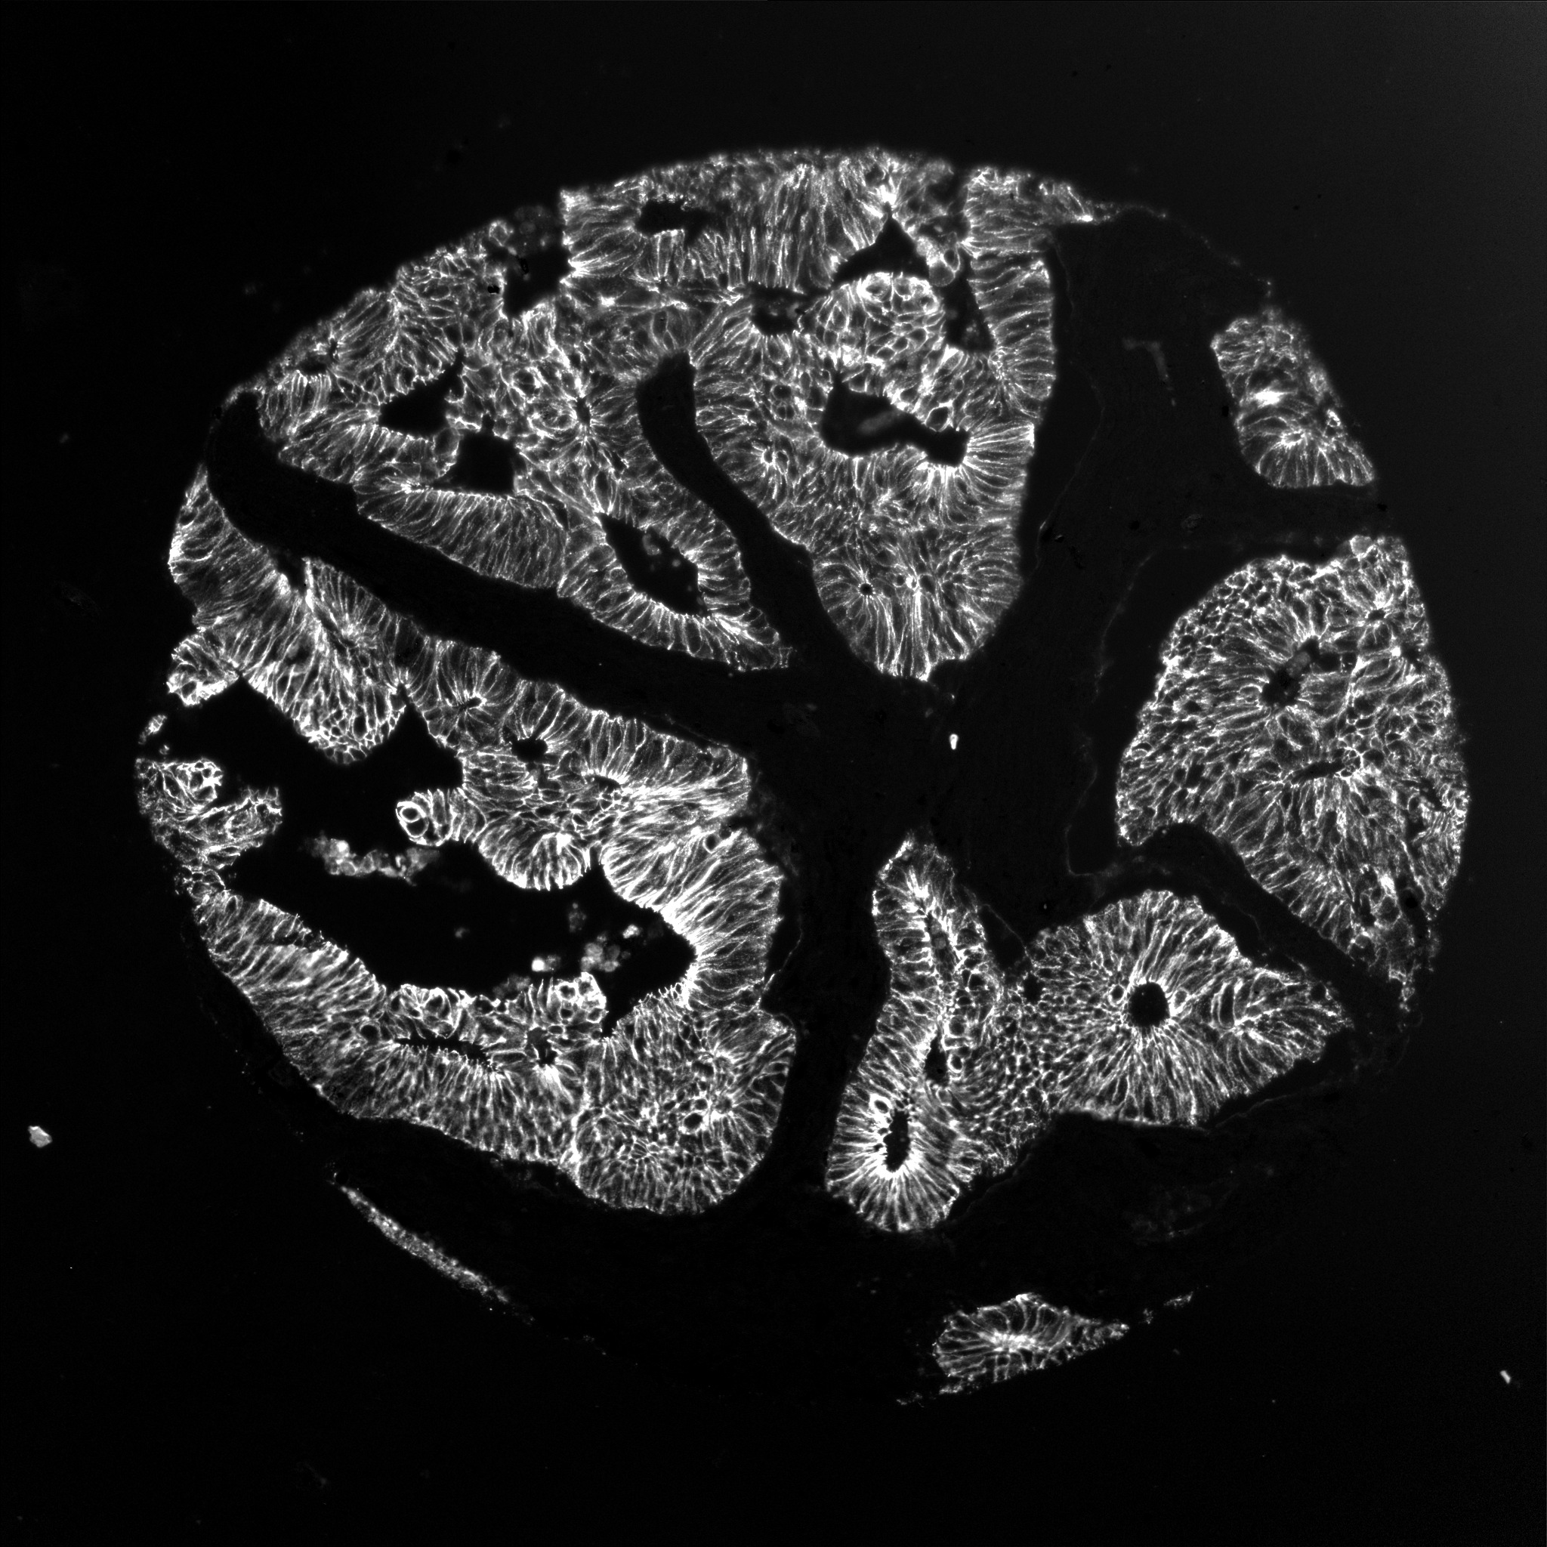
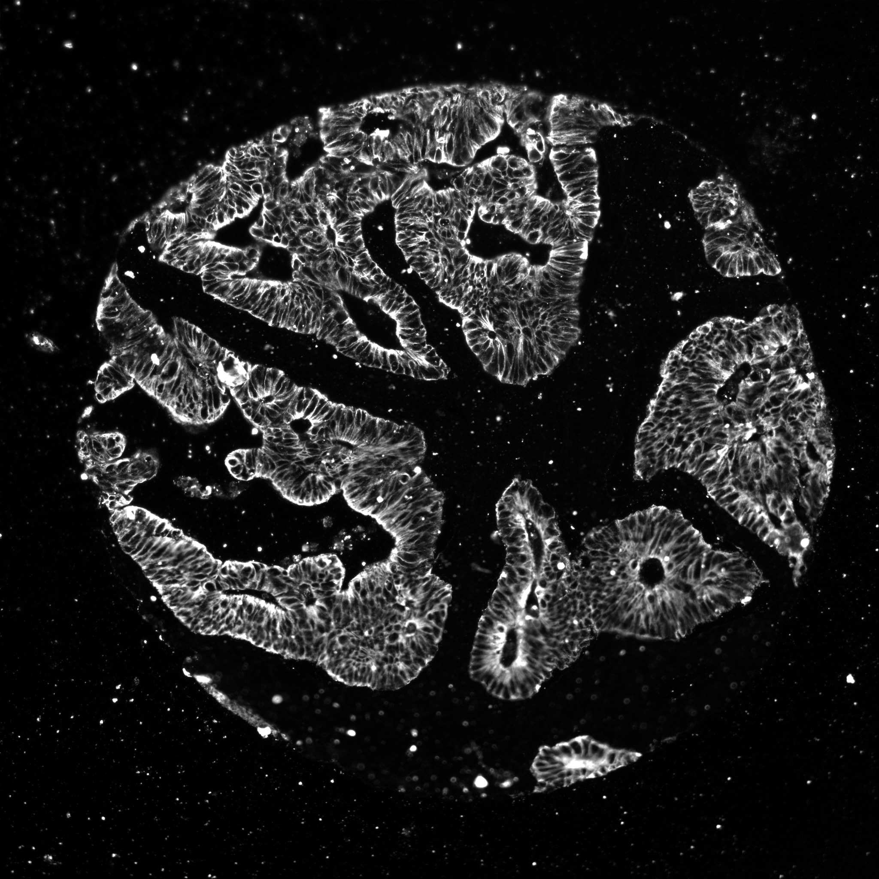
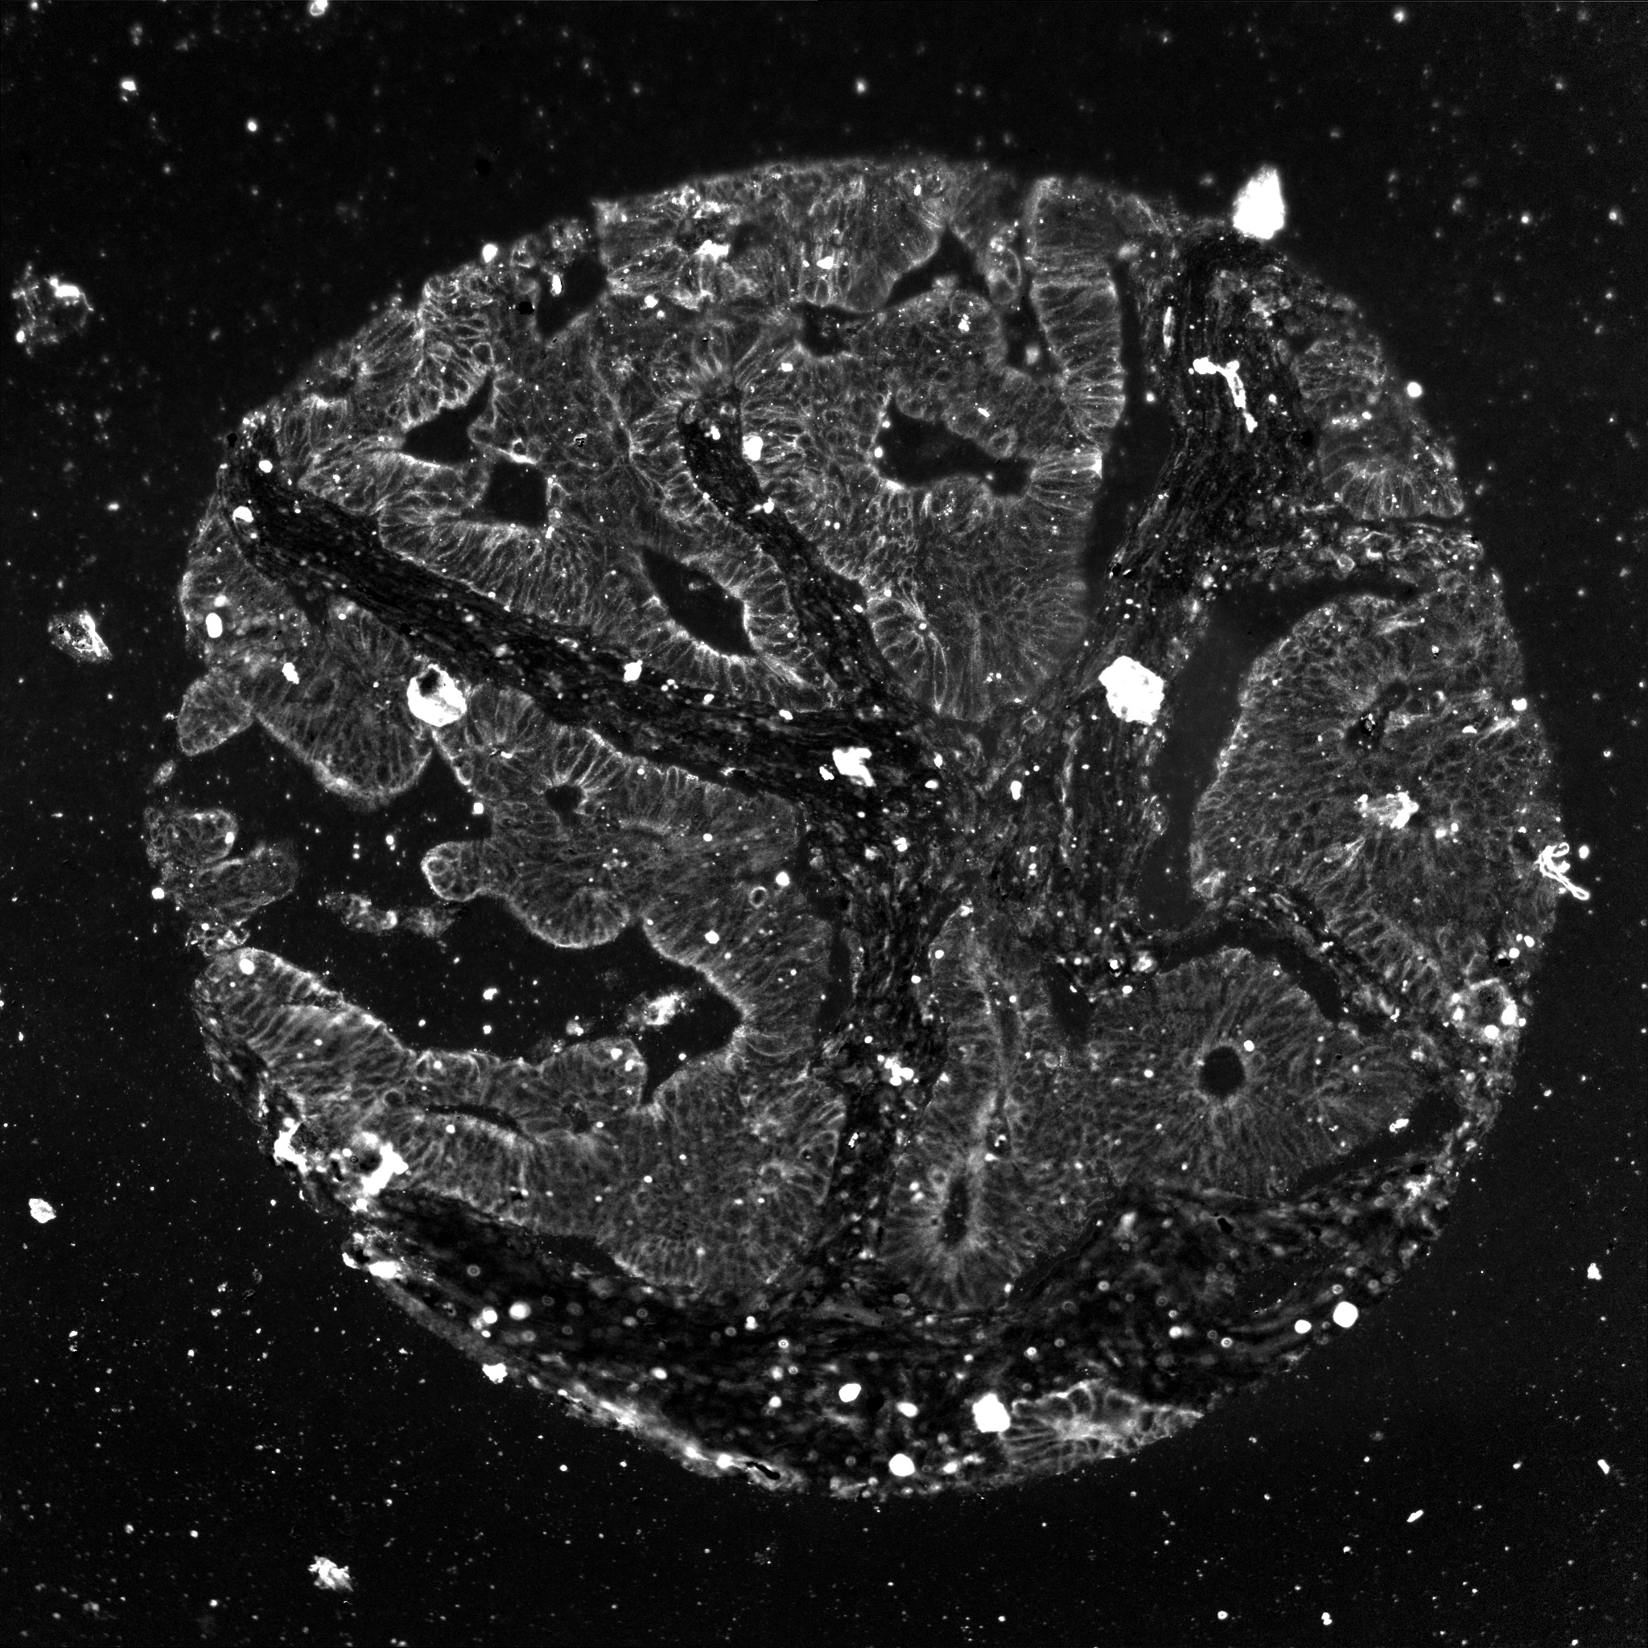
Data
Markers E_cad, CK15 and pck26 were used for this analysis.
Images were annotated as good (high signal) or bad (low signal) by pathologist.
E_cad
pck26
CK15

Slide 27
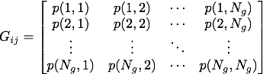
Methods
Haralick texture features [1] were used in categorizing image representations.
A set of 13 texture features were computed based on the gray level co-occurence matrix and the intensity information of the image.
The QoI score is defined as the probability that an image is from the good class. It is given by the following equation

Slide 28
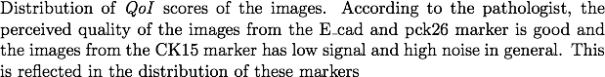
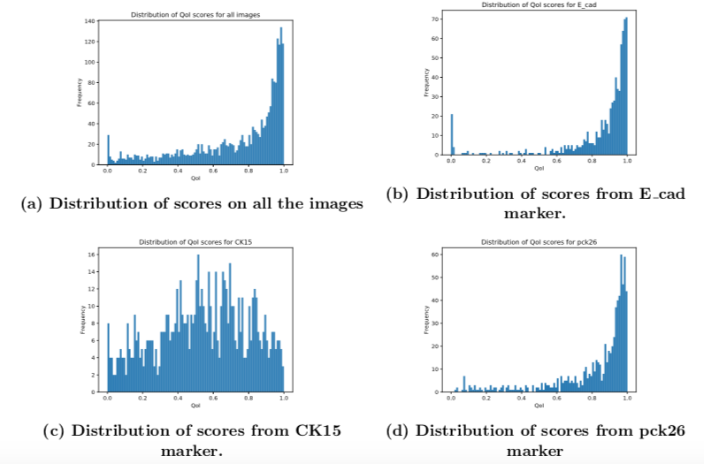
Results

Slide 29
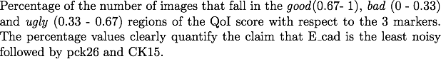
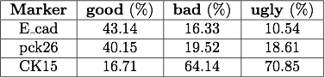
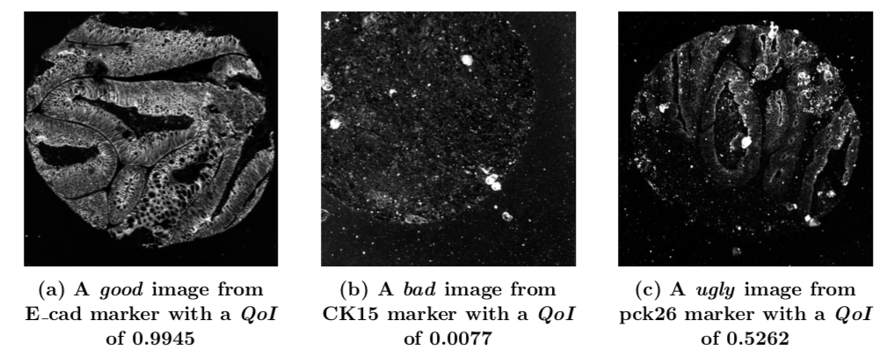
Results

Slide 30
Discussion
The QoI score maybe used to quantify the perceived quality of an image.
The QoI score maybe used to filter images or markers from a dataset.
This can be used as a pre-processing step to perform further analysis of medical images.

Slide 31
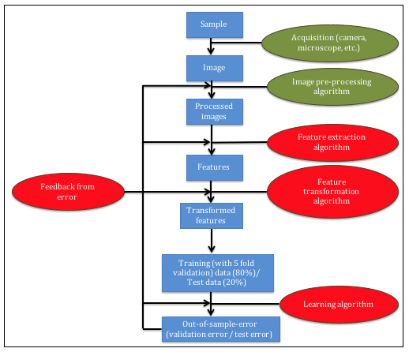
Quantification of error contribution from computational steps, algorithms and hyper-parameters [4]
Chowdhury, Aritra, et al. "Algorithm selection and hyperparameter optimization based quantification of error contribution in image classification pipelines.” IEEE International Conference on Data Mining (ICDM) 2018 (Submitted)

Slide 32
Introduction
Contribution of error from different components of image classification pipeline - steps, algorithms, hyper-parameters.
Provides data scientists and domain experts with insights about the pipeline in terms of which components are important for the performance of the pipeline.
Hyper-parameter optimization methods and algorithms to quantify error contributions - grid search, random search, Bayesian optimization.
Random search of configurations is able to accurately and efficiently compute the error contributions.

Slide 33
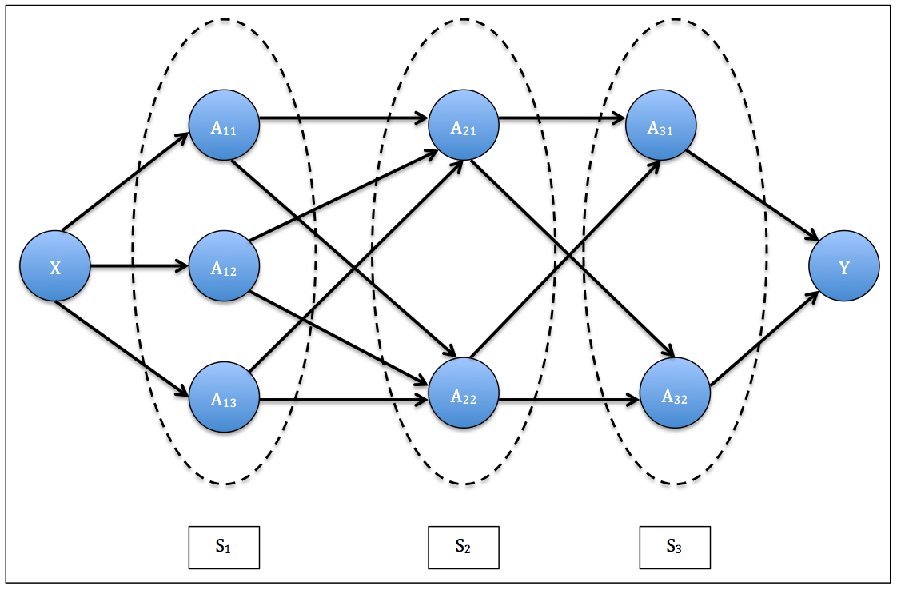
Image classification pipeline used in problem

Slide 34
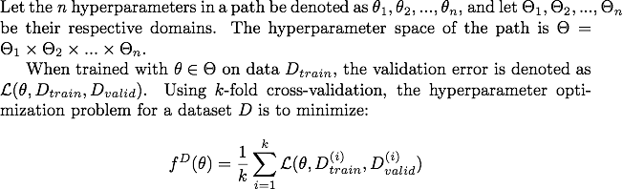
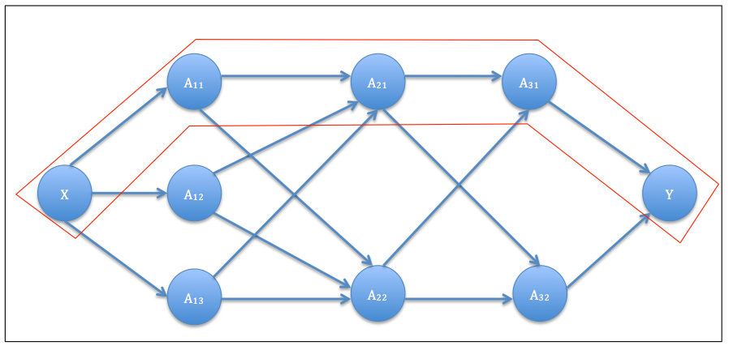
Hyper-parameter optimization (HPO)

Slide 35
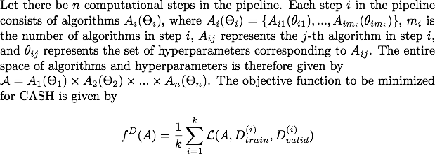
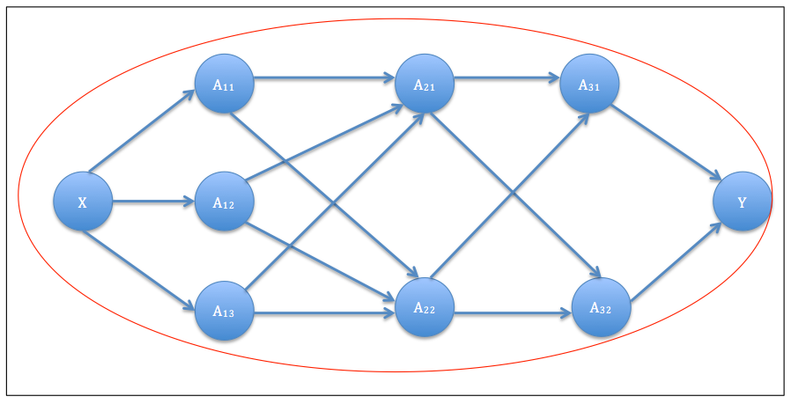
Combined algorithm selection and hyperparameter optimization (CASH)

Slide 36
Methods and algorithms for HPO and CASH
Grid- search
Random search
Bayesian optimization (Sequential model agnostic configurations)

Slide 37
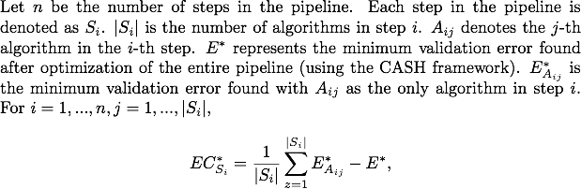
Error contribution from computational steps using the agnostic methodology

Slide 38
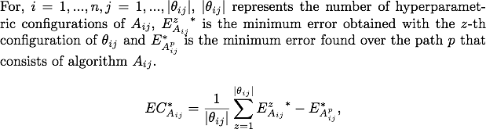
Error contribution from algorithms using the agnostic methodology

Slide 39
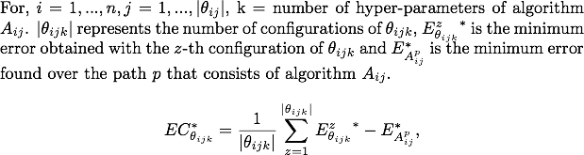
Error contribution from hyper parameters using the agnostic methodology

Slide 40
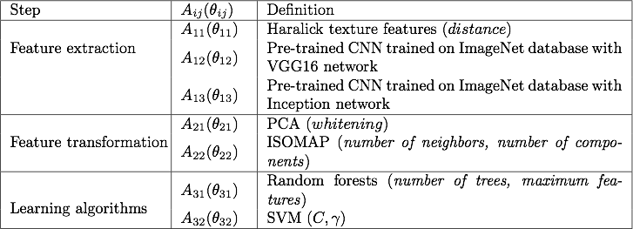

Experimental settings
Pipeline
Datasets

Slide 41




Random search quantifies the error contribution from steps, algorithms and hyper-parameters accurately and efficiently

Slide 42
Discussion
We propose a method to quantify the contributions of components in an image classification pipeline in terms of the error.
HPO and CASH methods maybe used to quantify error contribution and importance of components (steps, algorithms and hyper-parameters)
Random search is able to quantify the contributions accurately and efficiently based on the results.

Slide 43
Conclusion
The error observed in image classification pipelines is due to the components of the pipeline and not just the error due to the learning algorithm.
The error maybe reduced or minimized by :
Modifying or optimizing the individual components of the pipeline.
Modifying or optimizing the components of the pipeline as a whole.
The quality of the image classification pipeline can be estimated by :
Quantifying the quality of the data using a machine learning based score
Quantifying the contributions of the components of the pipeline (steps, algorithms and hyper-parameters)

Slide 44
Future work
Parametric 3D models can be used to redress data imbalance in other domains.
Exhaustive grid search and other CASH or HPO methods maybe used for optimizing image classification pipelines in other domains.
The Quality of Image (QoI) score maybe used to filter datasets into good data and bad data using a data driven approach.
The agnostic methodology maybe used for quantifying the error contributions in end-to-end learning frameworks for images and other sources of data.

Slide 45
References
Chowdhury, Aritra, et al. "Blood vessel characterization using virtual 3D models and convolutional neural networks in fluorescence microscopy." Biomedical Imaging (ISBI 2017), 2017 IEEE 14th International Symposium on. IEEE, 2017.
Chowdhury, Aritra, et al. "Image driven machine learning methods for microstructure recognition." Computational Materials Science 123 (2016): 176-187.
Chowdhury, Aritra, et al. "A machine learning approach to quantifying noise in medical images." Medical Imaging 2016: Digital Pathology. Vol. 9791. International Society for Optics and Photonics, 2016.
Chowdhury, Aritra, et al. "Algorithm selection and hyperparameter optimization based quantification of error contribution in image classification pipelines." IEEE International Conference on Data Mining (ICDM) 2018 (Submitted)

